Slide 1

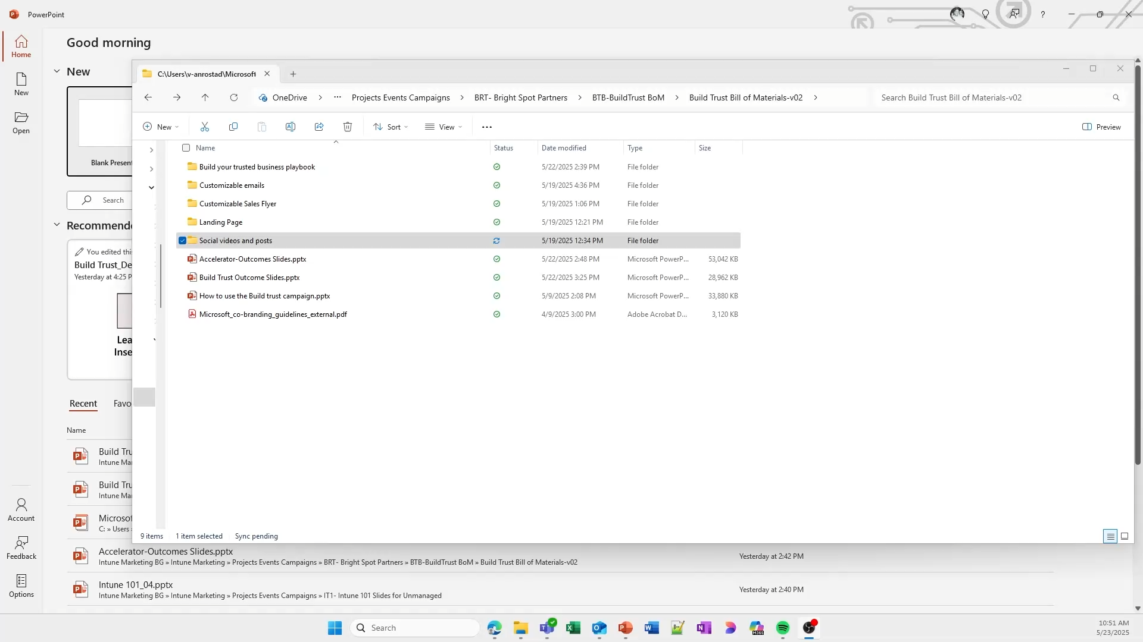

Protect my devices – Social Videos
Customization instructions (play video at right)
Open the video template PPT from your desktop, not a browser window.
Click the “Enable Editing” button if it prompts you.
Edit the text containing “Insert URL Here” with the web address of your landing page.
Right-click on the image and select ’Change picture’ to add your logo.
Click File > Export > Create a Video.
Select “Full HD (1080p)” from the menu.
Ignore ‘Seconds spent on each slide’ field and click the “Create Video” button.
Name your file and click the “Export” button to save it to your computer. Check it for accuracy.
Upload the video(s) to your social media platform.

