Slide 1
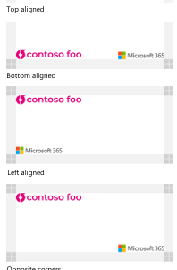
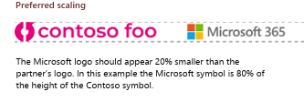
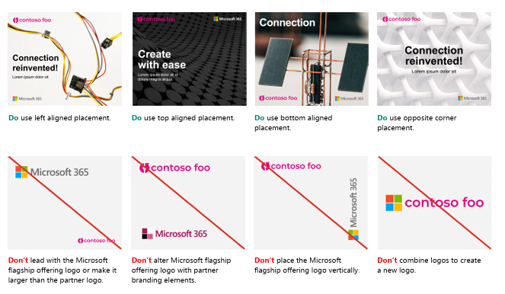
Select Customization Rules
Your logo always leads—and is placed in the upper left or lower left corner as shown at right.
The Microsoft 365 logo should appear 20% smaller than your logo as shown below.
For complete rules see the included Microsoft_co-branding_guidelines_external.pdf
Do
Don’t

Slide 2
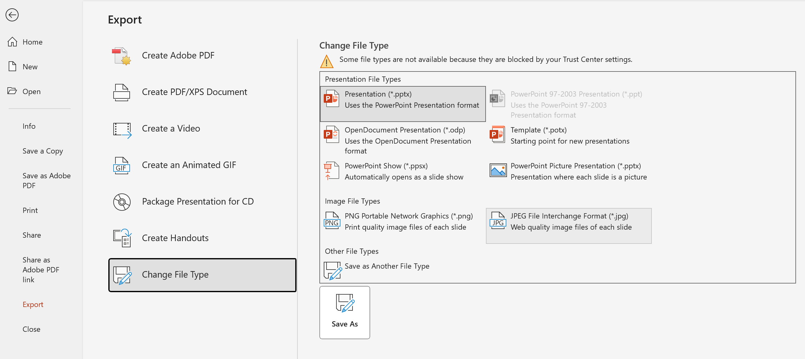
Protect my devices – Social Posts
Export Instructions
Select File > Export > Change File Type
Select “JPEG File Interchange Format” from the menu.
Select “Save As” Name your file and click the “Export” button to save it to your computer. Check it for accuracy.
Upload the files to your social media platform(s).

Slide 3
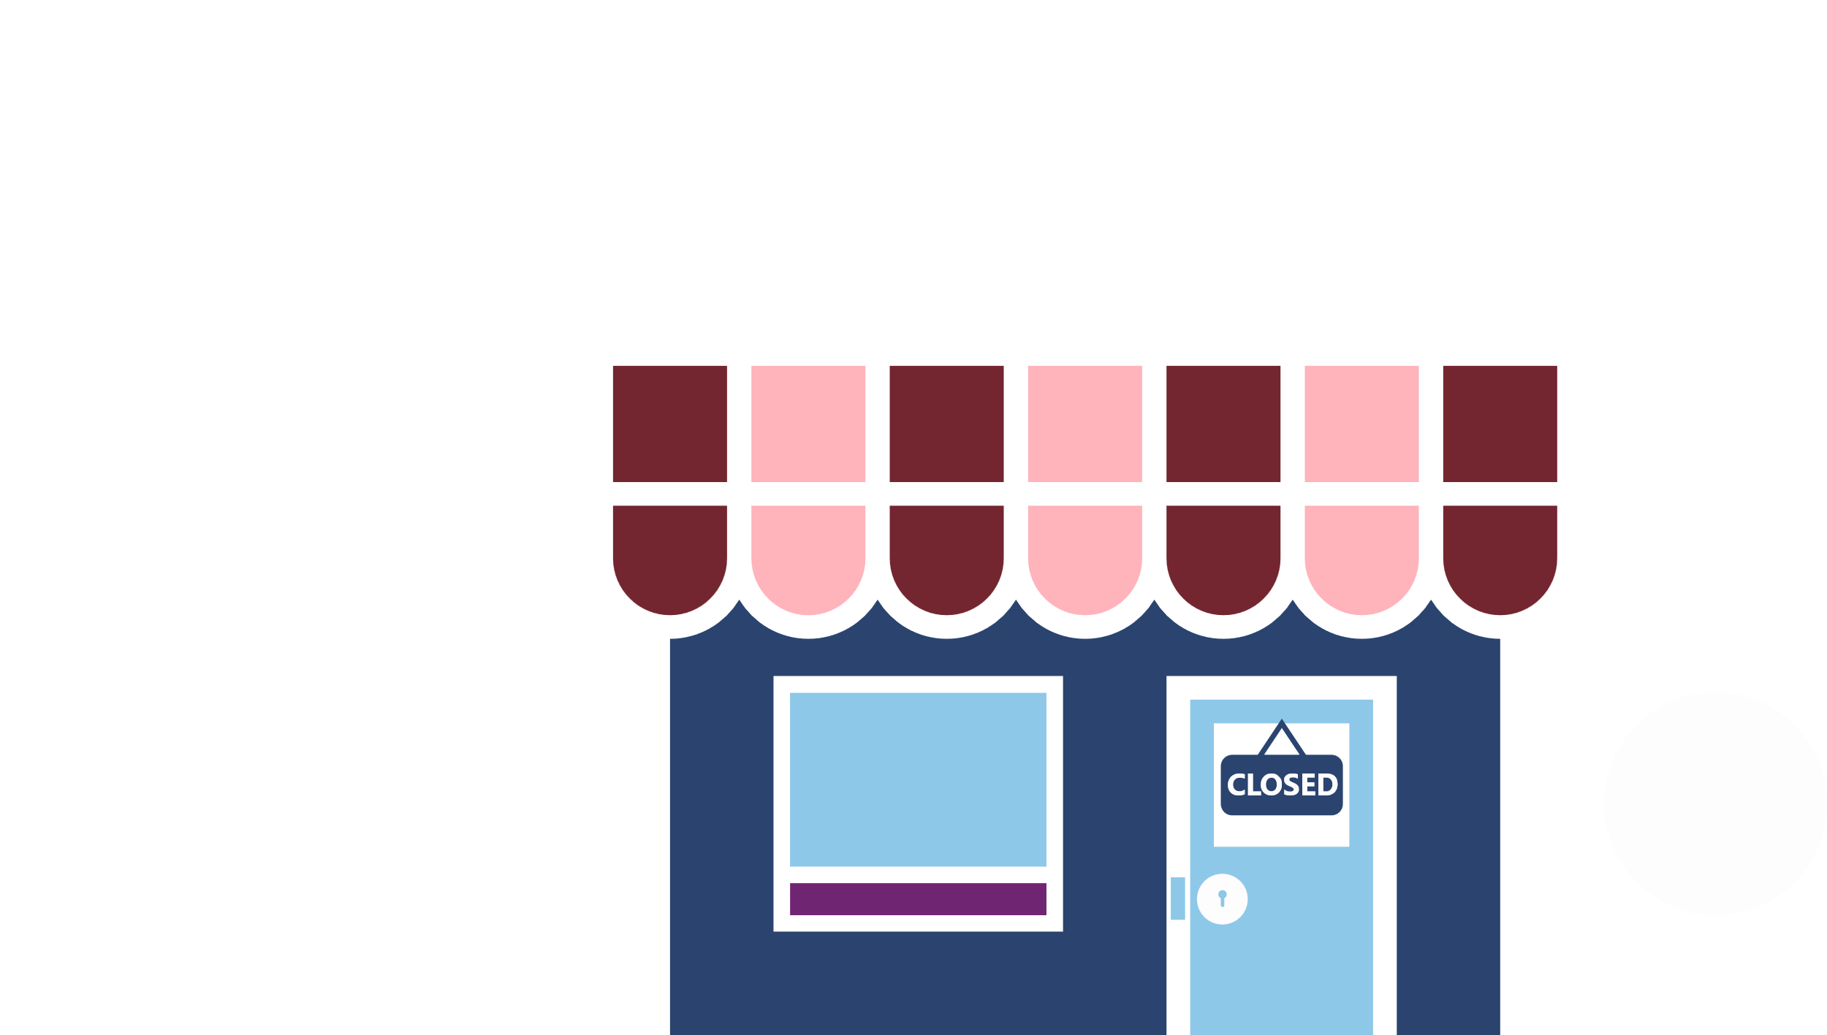
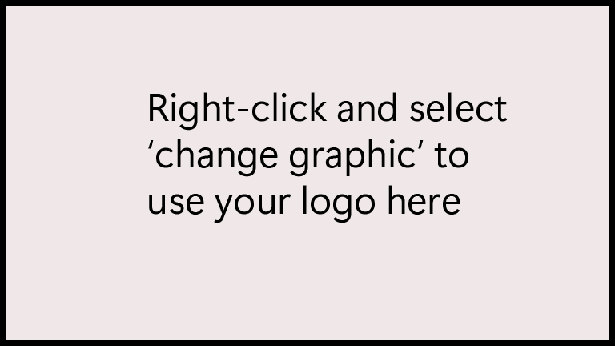
Comprehensive cybersecurity for your business

Slide 4
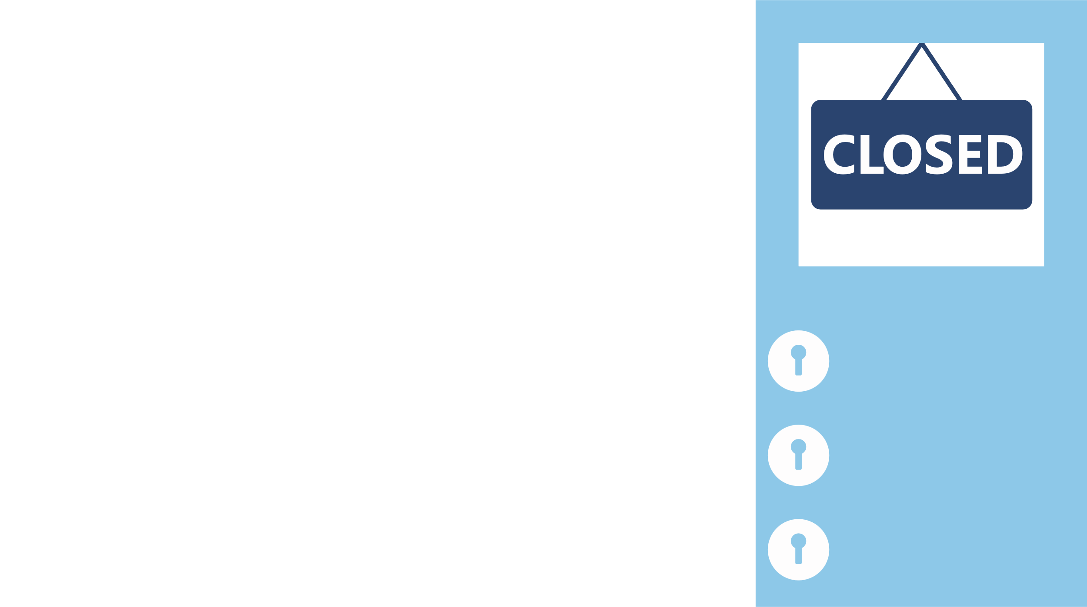
Ready to simplify your security solutions?

Slide 5
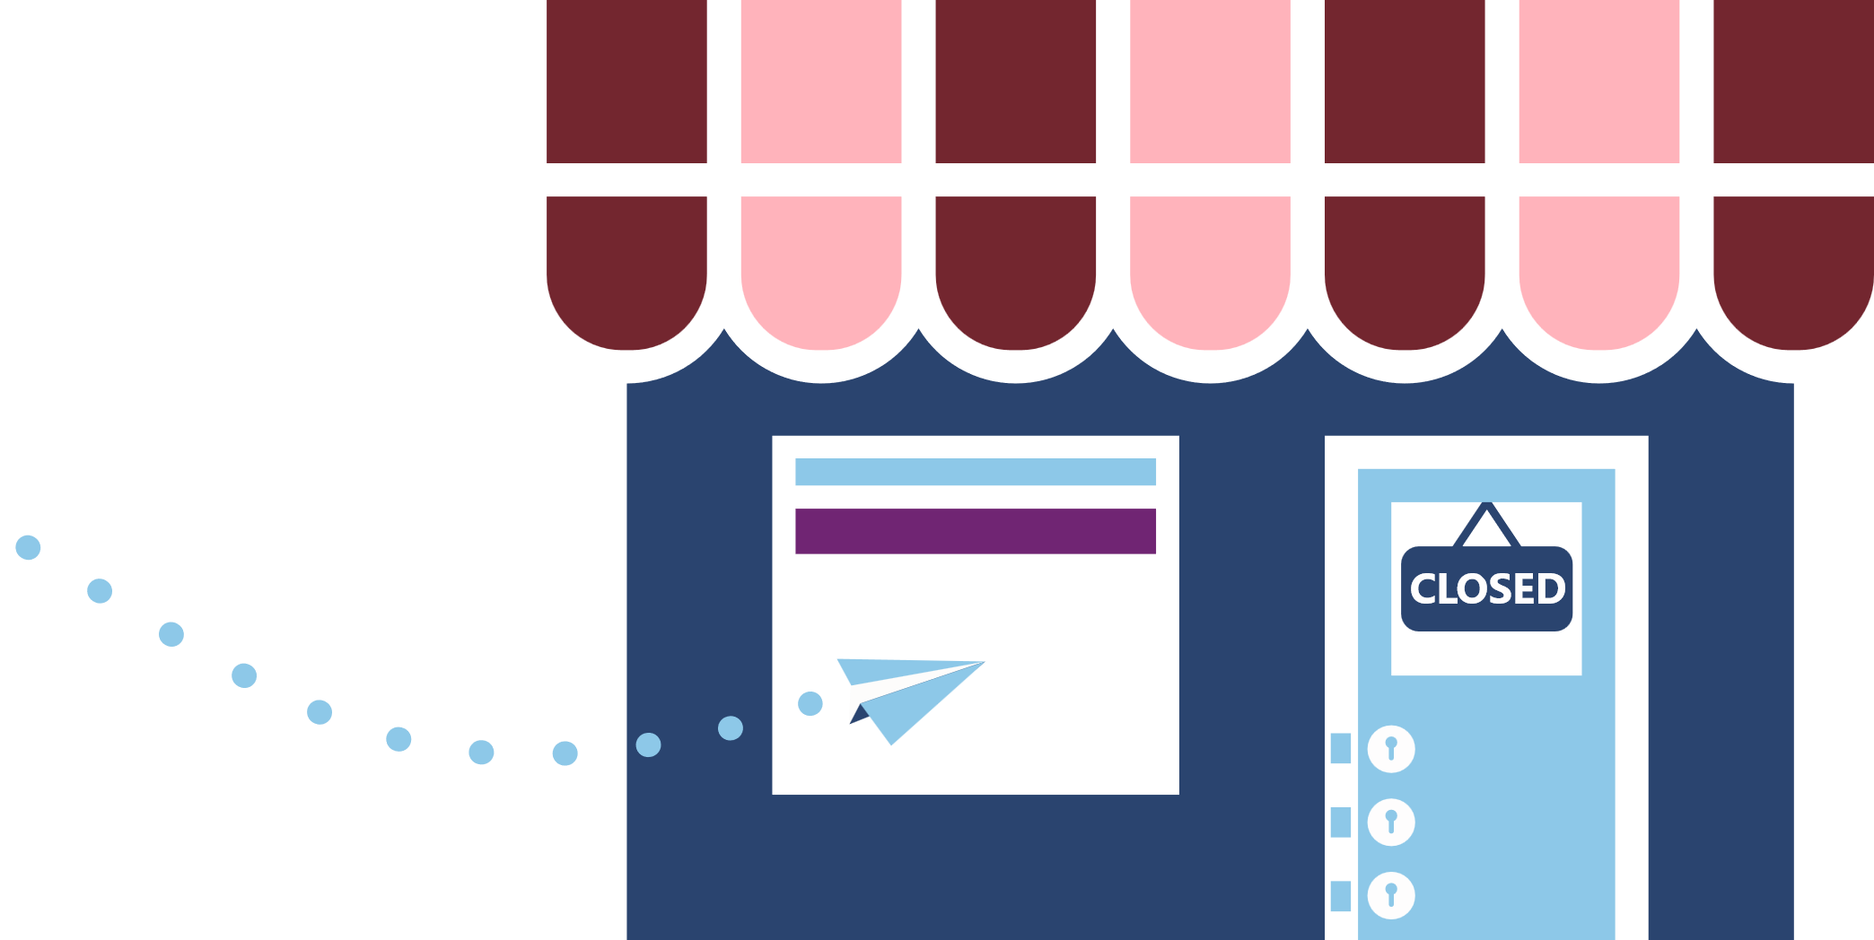
Do you have gaps in your business security?

Slide 6
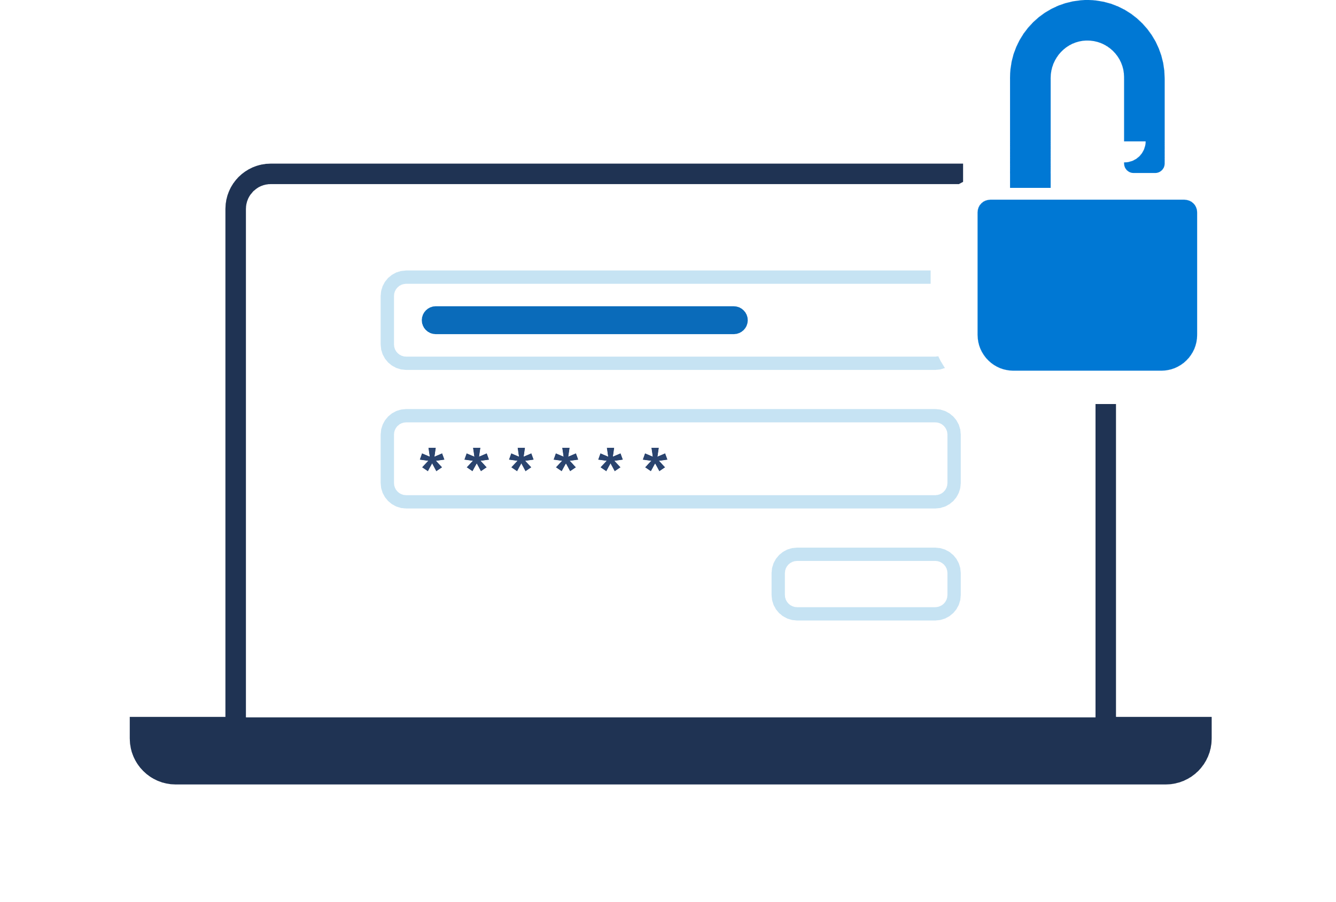
Help safeguard your business from growing cyberthreats

Slide 7
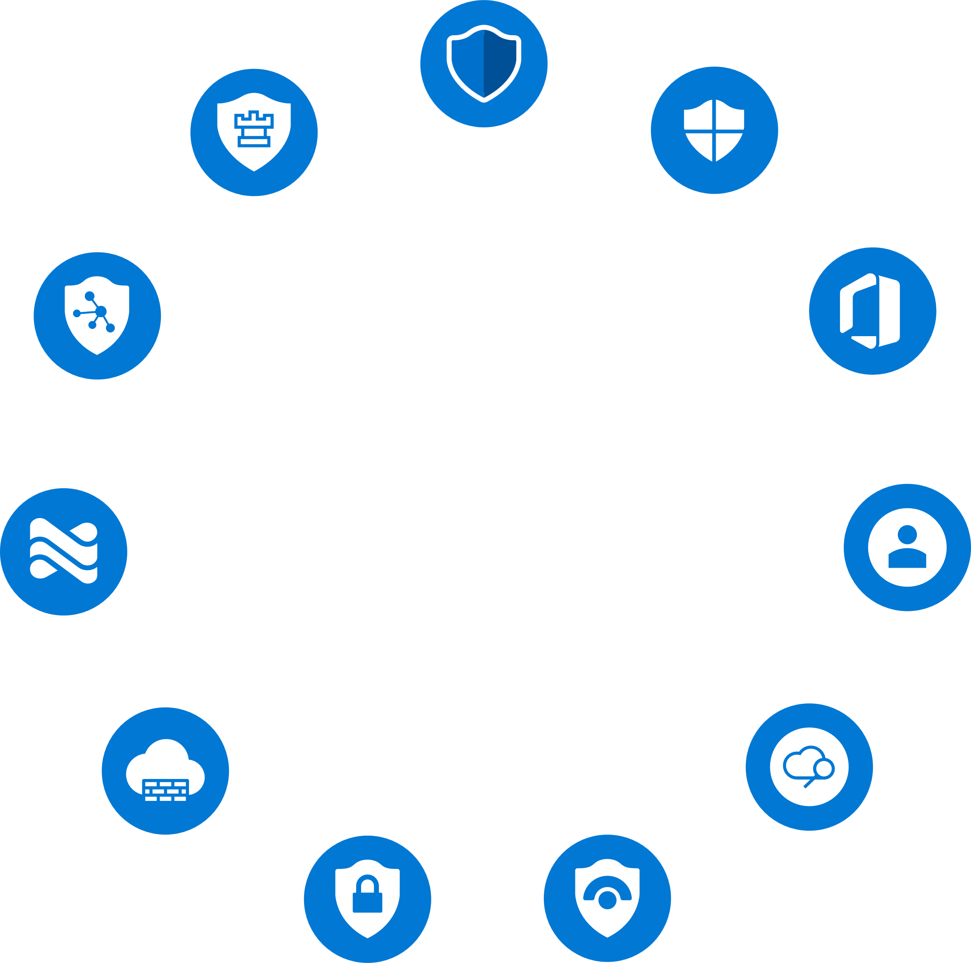
More productivity and security for your devices

Slide 8
Strike a balance between protection and productivity

Slide 9
Protect work data on your personal and company devices

Slide 10
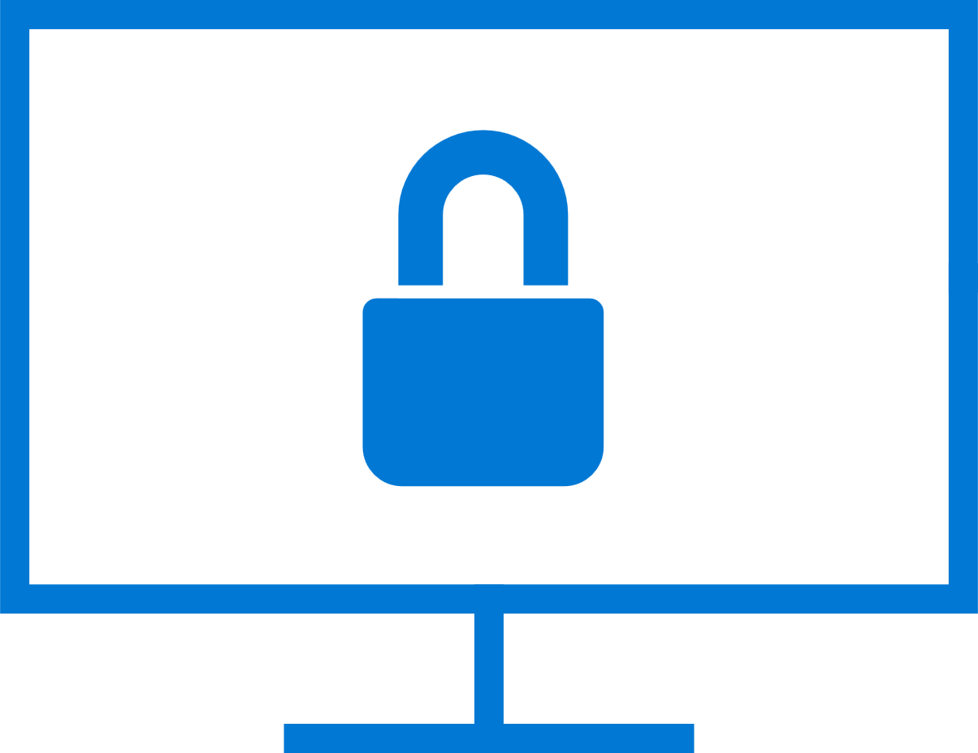
Access your apps and data more securely

